Slide 1


Yelp Innovation Challenge Analysis

Slide 2
The Team
SAIKRISHNA NELLUTLA—Python Programmer
RAMAKRISHNA RAJU VATSAVAI—R Programmer
PURNENDH PARUCHURI—Tableau Developer
MEGHA KAMRA—Data Preparation, R Programmer

Slide 3
What is Yelp?
Yelp, a review based online website, allows users to post their reviews out of their experience.
This review includes a text review or a star rating out of 5 or both. Yelp also allows its user’s to upload a photo along with their reviews.

Slide 4
Why is there a need for Analysis?
There is a lot of inaccuracy between a text review and its respective star rating given by a user for a particular business on Yelp.
Predicting the scores from text reviews for the business is known as the Review Rating Prediction.
The essence of this project is to make use of Yelp text reviews to predict accurate scores for each business and use this for the recommendation for new users based on their demographic location.
In addition to this, exploratory data analysis on this dataset can give insights about the businesses.
This will help the highest negative reviewed businesses to improve their services.

Slide 5
An example of an imperfect review and rating
A user X gave the following review and star rating:
“I really love the food here. I would take my girlfriend here next time”, Stars: 3/5
Just 3 ?????

Slide 6




Do reviews and ratings really matter?
BOX-OFFICE OPENING WEEKENDS:
BvS: $166 million Justice League: $93 million

Slide 7
Sentiment Analysis
Sentiment analysis (sometimes known as opinion mining or emotion AI) refers to the use of natural language processing, text analysis, computational linguistics, and biometrics to systematically identify, extract, quantify, and study affective states and subjective information.
Sentiment analysis is widely applied to voice of the customer materials such as reviews and survey responses, online and social media, and healthcare materials for applications that range from marketing to customer service to clinical medicine.

Slide 8
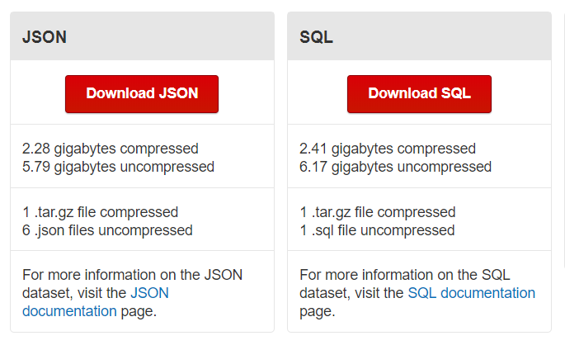
Dataset
Text Reviews dataset: 5.79 GB( JSON)
4,700,000 reviews
Business Dataset: 3.8 GB(JSON)
156,000 businesses
Dataset download Link:
https://www.yelp.com/dataset/download

Slide 9
DATASET ATTRIBUTES
REVIEWS DATASET
business_id
review_id
user_id
stars
date
text
useful
funny
cool
BUSINESS DATASET
business_id
name
neighborhood
address
city
state
postal_code
latitude
longitude
Stars, etc.

Slide 10
JSON TO CSV
The dataset was converted from JSON to CSV in R using the following libraries:
jsonlite
tibble
caret

Slide 11
DATA PREPROCESSING
Cleaned and Preprocessed the data.
Attribute Selection.
Joined the Attributes like State, City, and ZIP Code from business dataset to review dataset.
DATASET PARTITION:
Partitioned the dataset into 4 datasets based on the states.

Slide 12
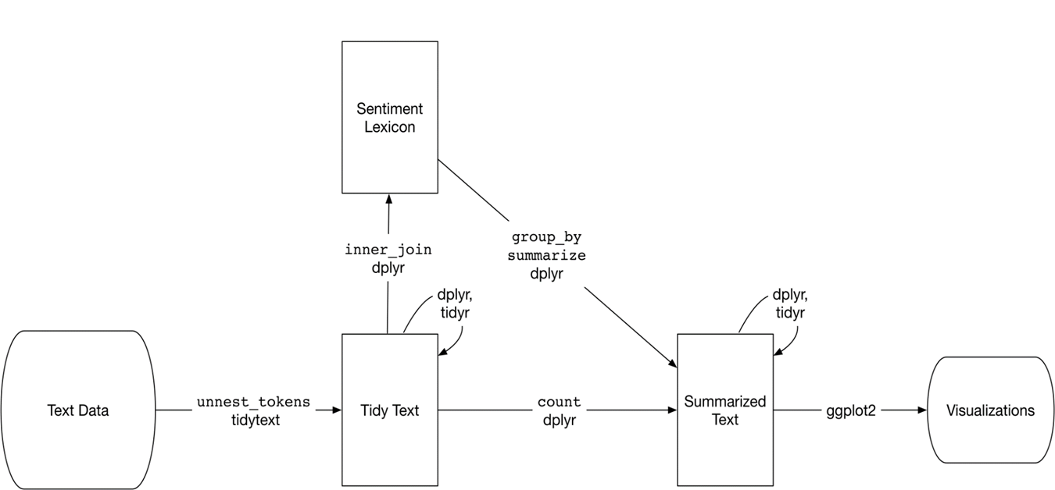
Sentiment Analysis in R

Slide 13
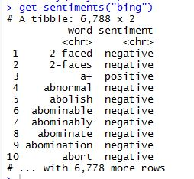
BING
Package tidytext
BING Sentiments:
Positive
Negative
It will classify the word with two labels(Positive or Negative)

Slide 14
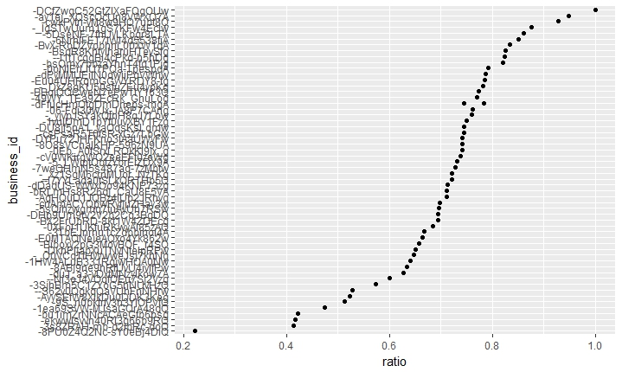
Business_id vs Positive percent for Cleveland City

Slide 15
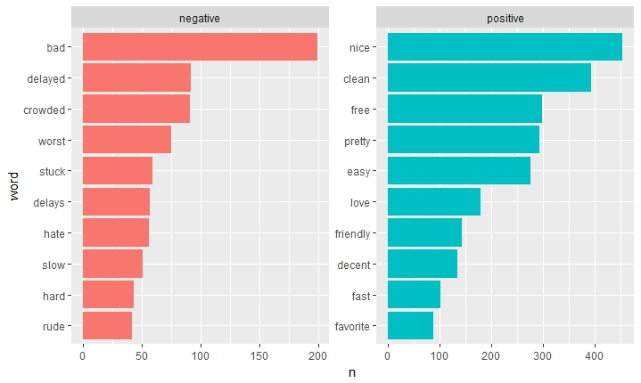
Top 10 Positive and Negative words for 1cLXGXThDYZ5WK_KpBLtkw

Slide 16
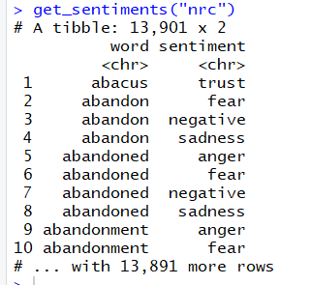
NRC
NRC Sentiments:
Positive
Negative
Fear
Anger
Trust
Sadness
Surprise
Disgust
Anticipation
Joy

Slide 17
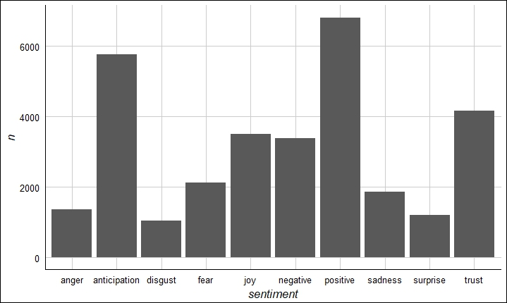
Frequency of Sentiments for yQab5dxZzgBLTEHCw9V7_w

Slide 18
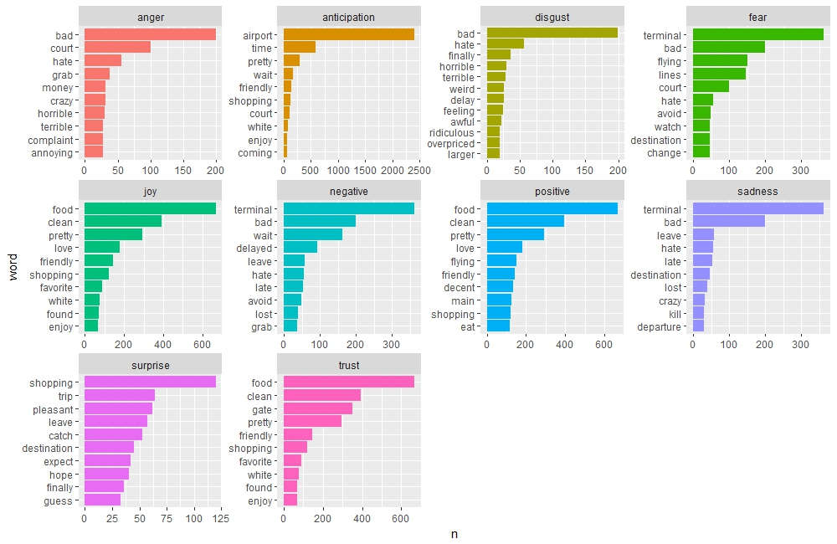
Top 10 Emotions for a Business Id

Slide 19

VADER
VADER (Valence Aware Dictionary and sEntiment Reasoner) is a lexicon and rule-based sentiment analysis tool that is specifically attuned to sentiments expressed in social media.
It will give sentiment score for any sentence between -1 to 1 based on the intensity.

Slide 20
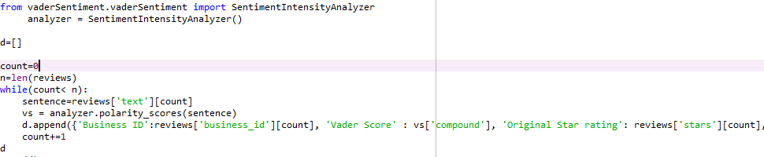
Vader Package Details:
Python Package: vaderSentiment

Slide 21
How is Vader different?
typical negations (e.g., "not good")
use of contractions as negations (e.g., "wasn't very good")
conventional use of punctuation to signal increased sentiment intensity (e.g., "Good!!!")
conventional use of word-shape to signal emphasis (e.g., using ALL CAPS for words/phrases)
using degree modifiers to alter sentiment intensity (e.g., intensity boosters such as "very" and intensity dampeners such as "kind of")
understanding many slang words (e.g., 'sux')
understanding many slang words as modifiers such as 'uber' or 'friggin' or 'kinda'
understanding many emoticons such as :) and :D
understanding initialisms and acronyms (for example: 'lol')

Slide 22
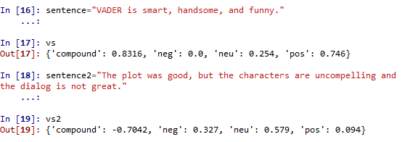

Let’s see how Vader handles sentences!

Slide 23
About the Scoring
The compound score is computed by summing the valence scores of each word in the lexicon, adjusted according to the rules, and then normalized to be between -1 (most extreme negative) and +1 (most extreme positive).
Typical threshold values used are:
5 stars : compound score >0.9
4.5 stars : compound score >0.75
4 stars : compound score >0.5
3.5 stars: compound score >0.25
3 stars: compound score >0
2.5 stars: compound score >-0.25
2 stars: compound score >-0.5
1 star: compound score >-0.75
0 stars: compound score <-0.76

Slide 24
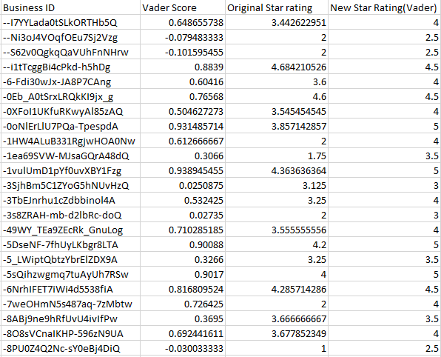
Ohio State

Slide 25
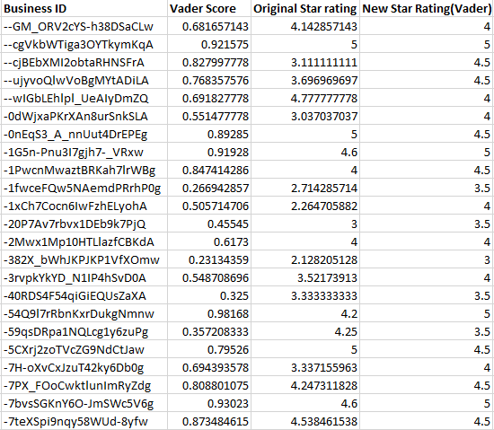
Pennsylvania State

Slide 26
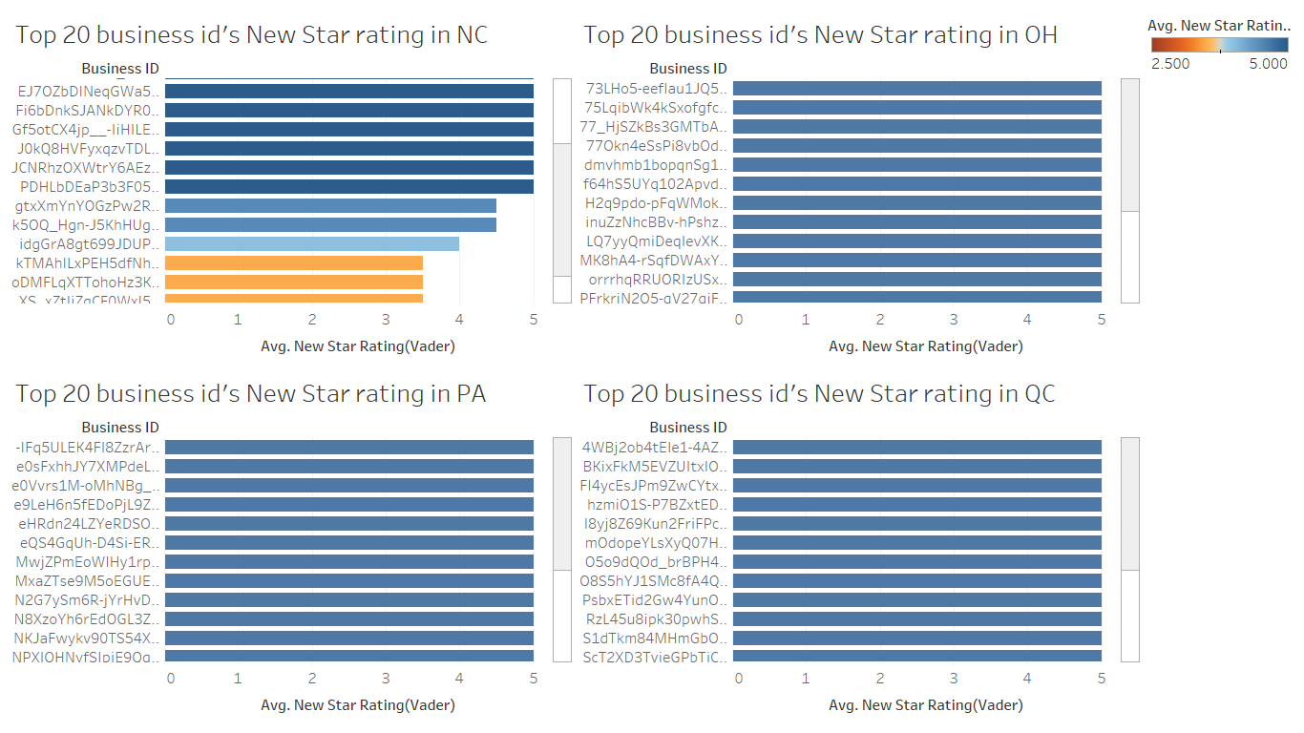
Visualizations (VADER)

Slide 27
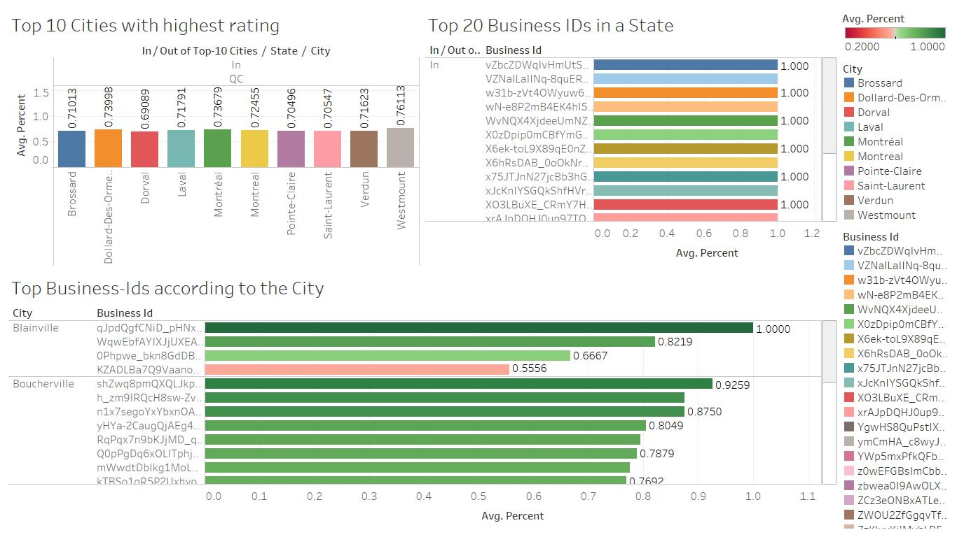
Visualizations(QC)

Slide 28
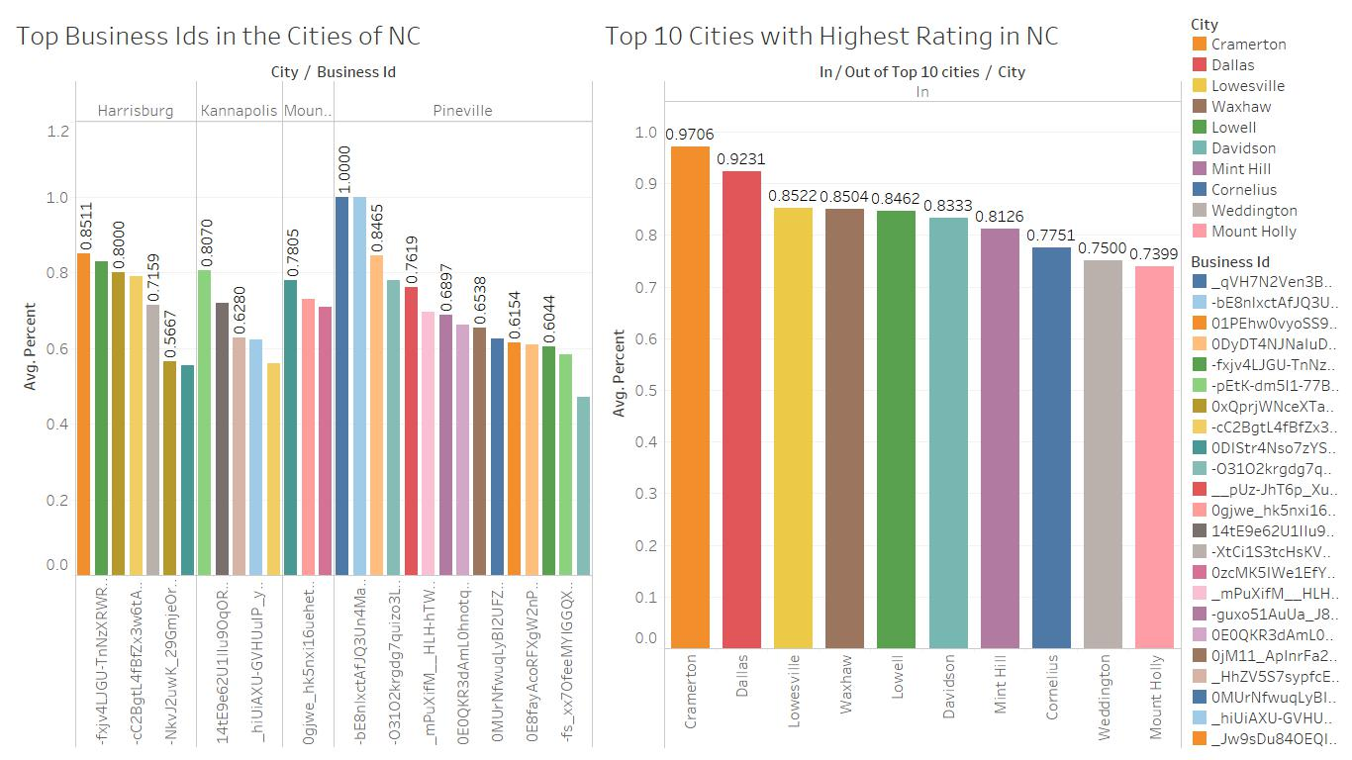
Visualizations(NC)

Slide 29
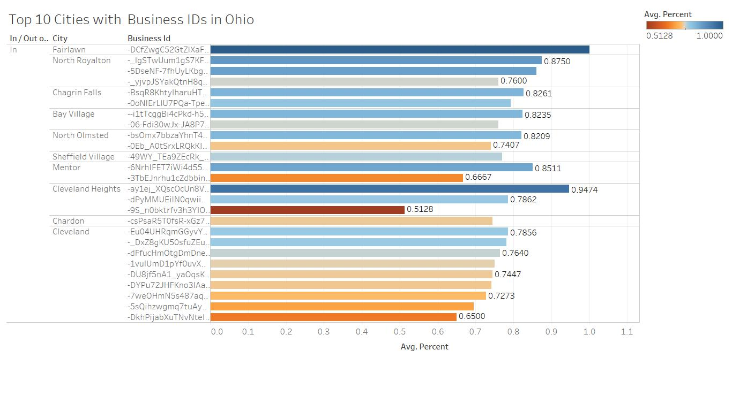
Visualizations(OH)

Slide 30
Summary
Yelp star ratings are not accurate.
Reviews are very important for businesses.
Introducing sentiment analysis would help the business as well as users to choosing best businesses in a particular area
BING in R and VADER in Python are used to predict star ratings for a particular business.
VADER was shown to be more effective in predicting an accurate star rating.

Slide 31
QUESTIONS?

Slide 32
THANK YOU

